Slide 1
OVERVIEW OF THE PROBLEM
Why ?
2619 accidents in last 2 yrs---- Hyderabad ORR
Fatal accidents were 4% of total accidents
Every 10-minute delay in treatment is associated with a 6% increase in the odds of a poor outcome*
Objective: To reduce the number of fatal accidents by minimizing the response time.
How?
Reducing the travel time of Emergency Services.
By optimising the ambulance location with respect to historic accident data.
Ensuring Coverage of each accident locations.
*Source- https://medicalxpress.com/news/2020-10-exploring-golden-hour-trauma-treatment.html

Slide 2
ACCIDENT DATA PREVIEW

Slide 3
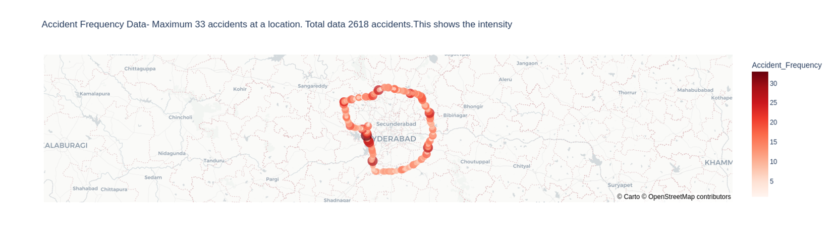
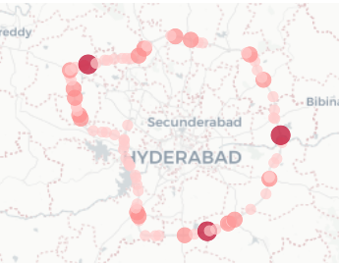
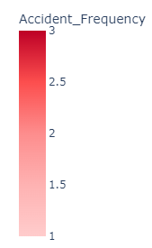
MAPPING OF ACCIDENTS
All accidents with intensity
Fatal accidents with intensity

Slide 4
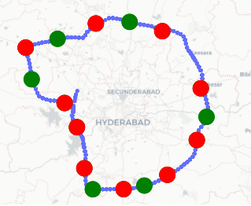
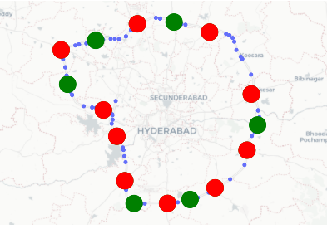
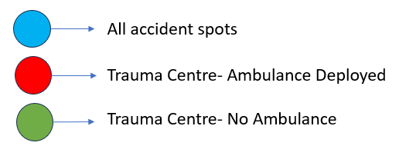
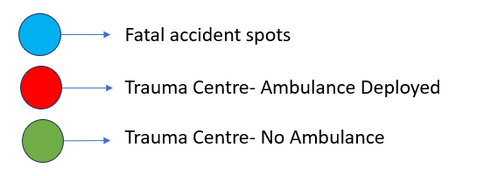
CURRENT & TOTAL AMBULANCE LOCATIONS
Hyderabad- ORR has 16 Trauma sources with 10 Ambulances over 157km length

Slide 5
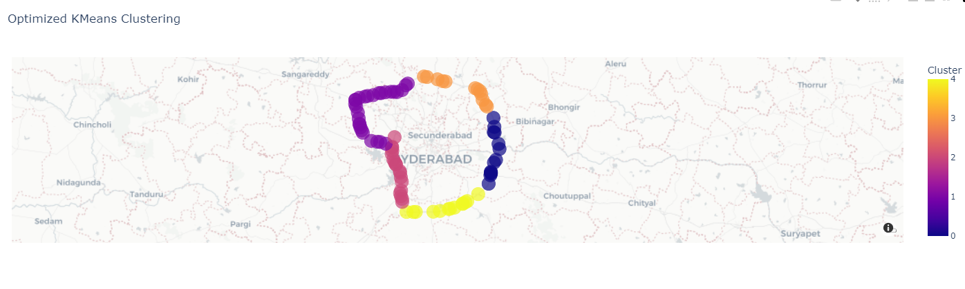
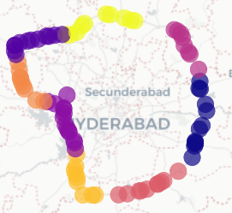
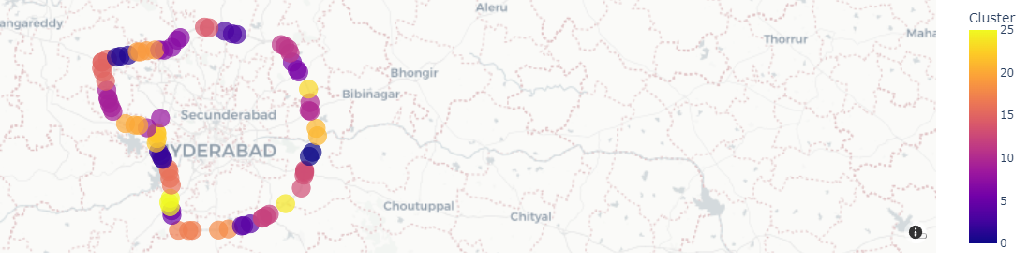
CLUSTERING FATAL ACCIDENTS
KMeans
With intensity
Without intensity
Clustering wrt Freq and Optimisation, N= 5 elbow point
Clustering wrt Lat-Lon N=8 elbow point for Fatal acc. & N=26 for all accidents
N-> based on:
1- Silhouette Score | 2-Davies Bouldin Index

Slide 6
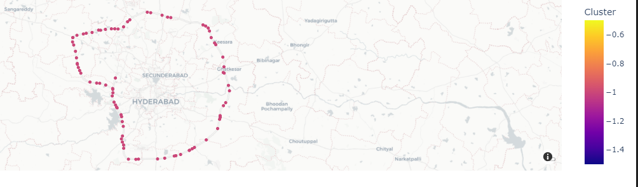
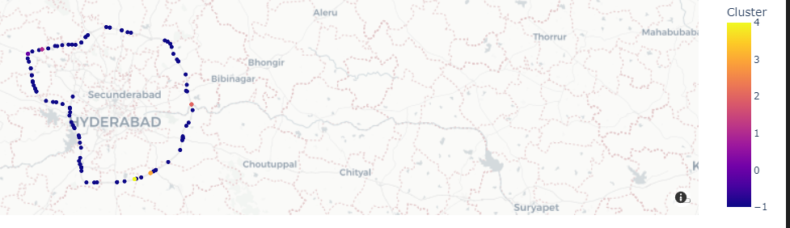
CLUSTERING FATAL ACCIDENTS
DBSCAN
With intensity
Without intensity
Clustering wrt Accident Freq leads to each data point classified as single cluster -1
Clustering with Lat Lon and 300m tolerance radii leads to -1 “no cluster” to most locations
For ε= 350m leads to Silhoutte score= 0.94 and min no. of noises off all iterations
ε – 300m
min_sample=3

Slide 7
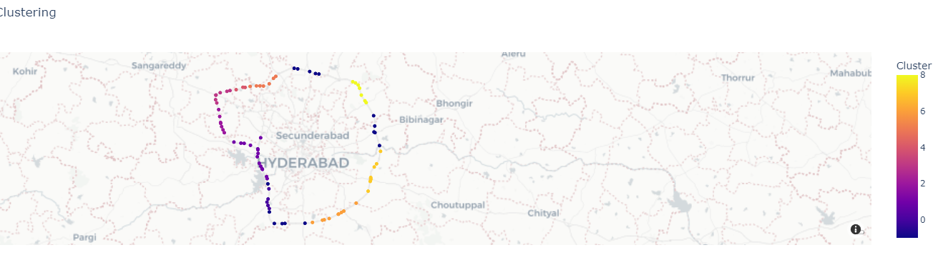
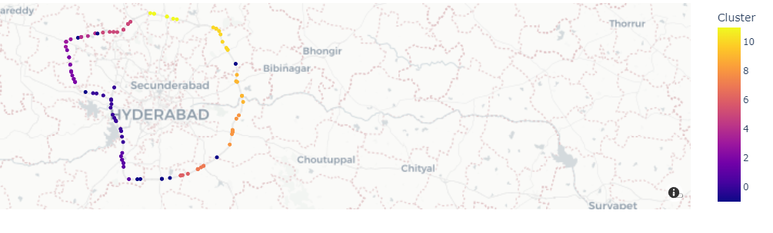
CLUSTERING FATAL ACCIDENTS
OPTICS
With intensity
Without intensity
N=8 for Clustering wrt. Accident frequency
N=10 for Clustering wrt Accident Lat-Lon only.
min_samples=5
min_cluster_size=3

Slide 8
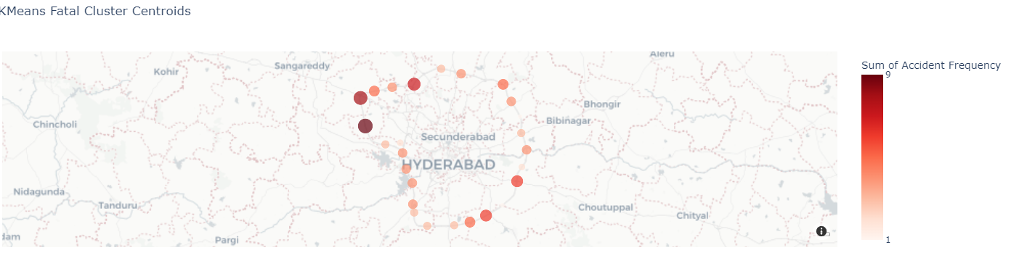
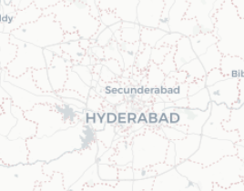
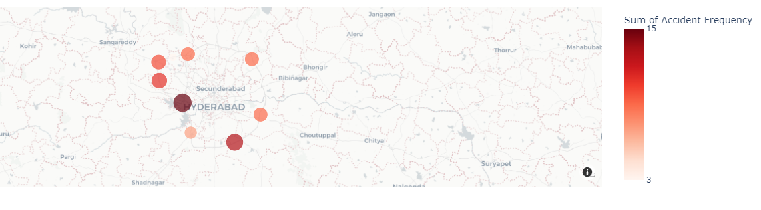
CENTROIDS OF EACH CLUSTER PLOTTED
KMeans | DBSCAN | OPTICS
1
9
3
15
Well defined clusters covering all the location
No centroid since labels -1
Only identified major points but did not account for other regions with potential accidents

Slide 9
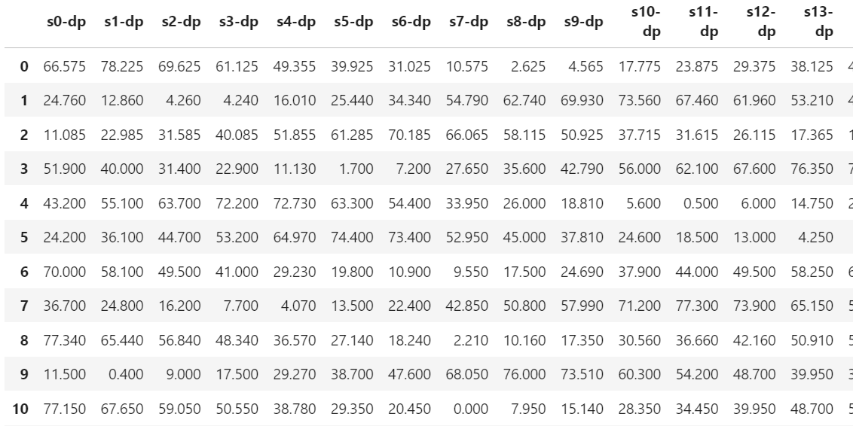
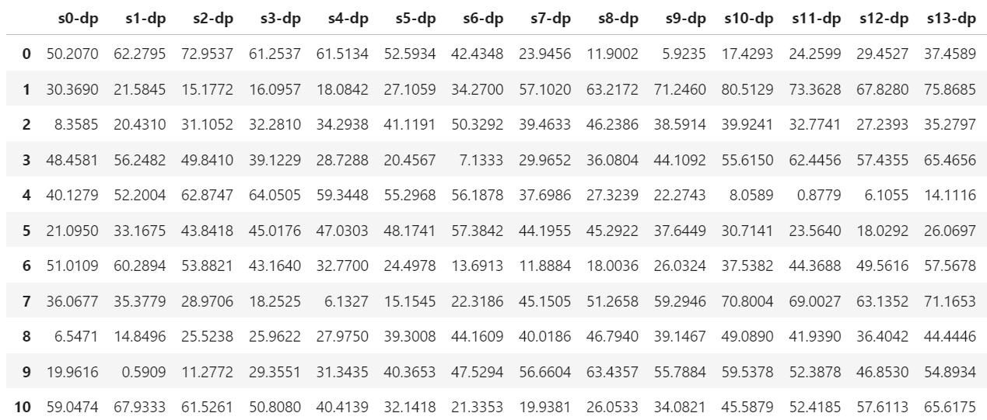
OD DISTANCE-TIME MATRIX
1. Chainage based Distance Matrix
2. API based Distance Matrix
Comparison
The distance calculated with chainage considers the shortest distance clockwise and anti-clockwise
The distance calculated using OpenStreetMap takes shortest route from ambulance source to Demand Point
*Assumed V=110km/hr

Slide 10
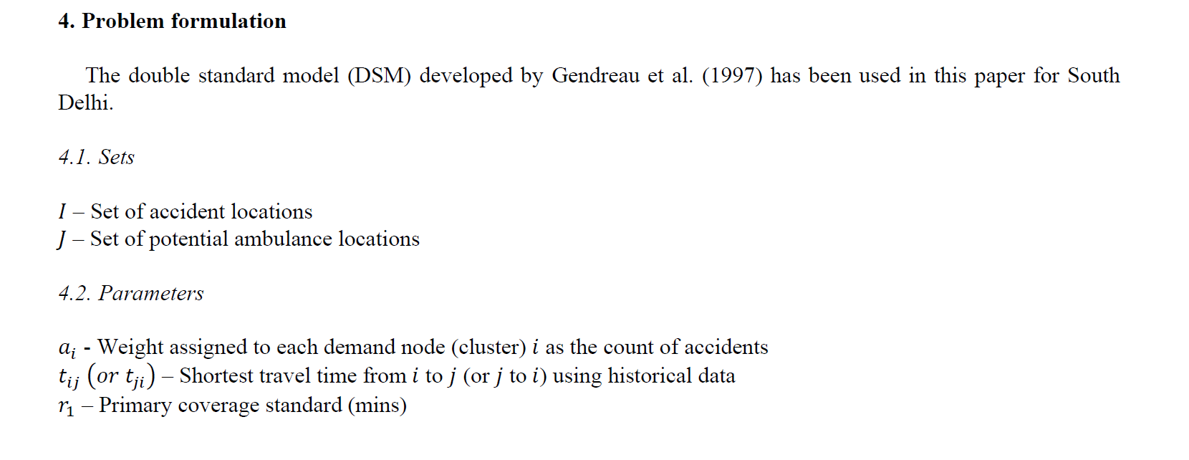
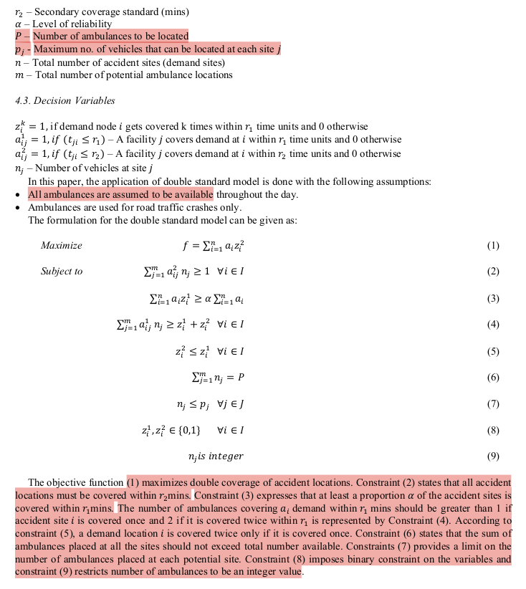
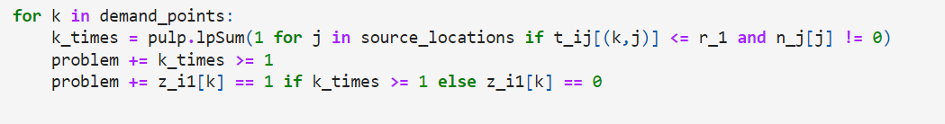
OPTIMIZATION MODULE
26 - KMeans
16
Weightage matrix calculated→ [2, 5, 4, 4, 5, 3, 4, 7, 2, 9, 3, 5, 6, 6, 3, 8, 4, 3, 3, 4, 3, 4, 4, 1, 1, 4]
Time Matrix calculated (Chainage, API based)
[8,10,12,14,16,18,20]
[12,14,16,18,20,22,24]
[0.80,0.85,0.90,0.95,1.0]
16
2
26
16

Slide 11
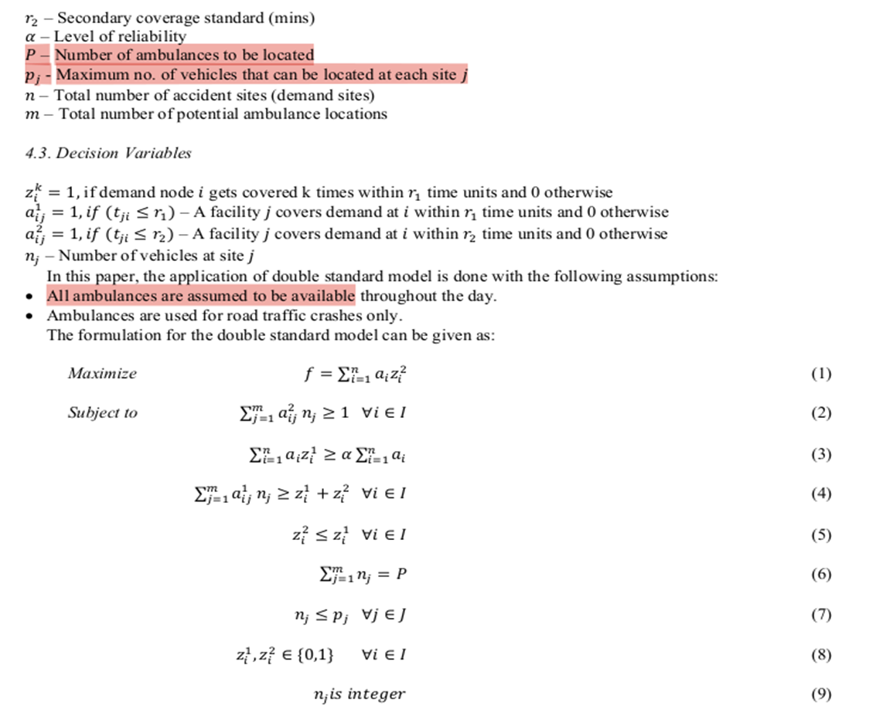
Difference from the paper
No spatial outliers in ORR data (Uniformly distributed data)
Clustering using ML Models no ArcGIS
Weights different for each location
Time matrix = Distance Matrix/v assumed
2 time matrices calculated
Strain on each ambulance 2.6/dp while paper→ 4.13/dp
Variables understanding and assumptions
r2 – based on news article on ORR about avg response time 16mins
Alpha taken in range from 0.7 to 1.0 with 0.05 steps

Slide 12
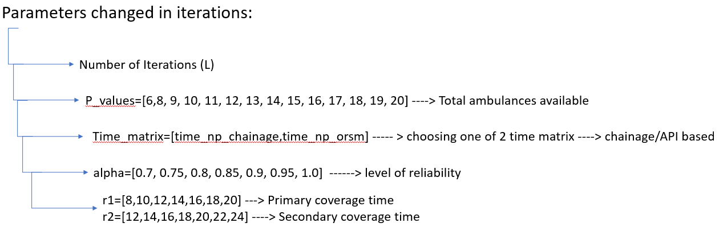
ITERATIONS

Slide 13
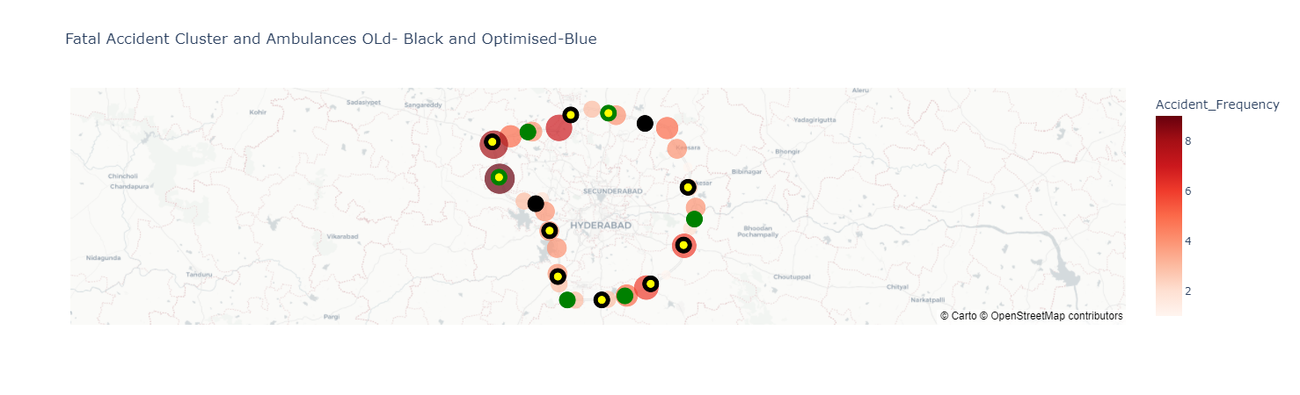
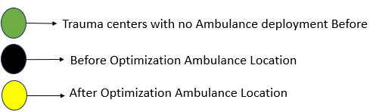
1
N=26
P=10
alpha=0.90
r_1= 8
r_2= 12

Slide 14

2
N=26
P=10
alpha=0.90
r_1= 10
r_2= 14

Slide 15

3
N=26
P=10
alpha=0.90
r_1= 12
r_2= 16

Slide 16
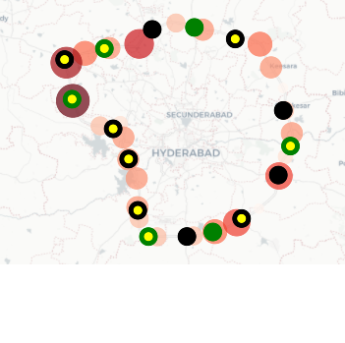
4
N=26
P=10
alpha=0.90
r_1= 14
r_2= 18

Slide 17
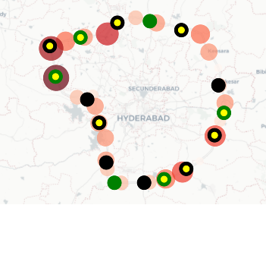
5
N=26
P=10
alpha=0.90
r_1= 16
r_2= 20

Slide 18
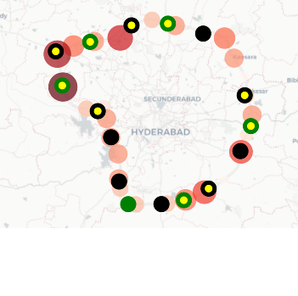
6
N=26
P=10
alpha=0.90
r_1= 18
r_2= 22

Slide 19
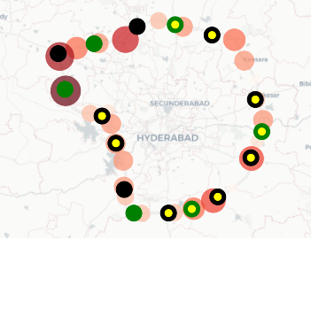
7
N=26
P=10
alpha=0.90
r_1= 20
r_2= 24

Slide 20
QUESTIONS
Q. 1- I have limited the total ambulances (P=10) and per site ambulances (pj=2). Does this affect the algorithm’s output? Q. 2- I used KMeans for clustering since the fatal accident dataset is uniformly spaced on the highway. Should I use DBSCAN instead, and if so, why? Q. 3- I calculated the Time matrix using OpenStreetMap and chainage distances (clockwise and anti-clockwise, this considers the fact that for emergency, Ambulances can travel wrong direction for quicker response). Which approach is better? Q. 4- The value zik=1 if demand node i is covered k times within r1 time units, and 0 otherwise. What does k=2 mean? Does it refer to the secondary response time? Q. 5- After using PuLP for optimization to maximize Σai*z2i , I am consistently getting a maximum value of 107.0, and 61.0 for other parameters. Given the objective is to maximize secondary coverage to all sites, is the maximum value better?
Q. 6- For optimization results, we get a max value of 107 (full coverage within 20 min). Should we choose the minimum 𝑟1 with max alpha or look at the plots on the map?

